Slide 1
JavaScript from the Ground Up Please sign in: http://bit.ly/1Qygjgs
Lesson 1: Statements Part 1
Brian Cui | Web Basic | MAD 2015

Slide 2
Expressions Recap
Last time we learned about expressions. The simplest expression is the literal, and expressions they can be used with operators to form new expressions. All expressions are truthy or falsy.
1 + 2 - "3" => 0
"I'm a string" + true => "I'm a stringtrue"
!!0 && !!1 => false
(("" && true) + "glue") || false => "glue"
(true === "true") => false
The list: + - / * % () && || ! == === != !== > < >= <=

Slide 3
Thoughts from Last Time…
"Too much focus on small details, needs to go back to overarching ideas and concepts more often in order to reinforce why the details are important."
"It would be helpful to have access to the slide deck."
"Things went a little bit too fast."
"Its okay for learning statements and stuff but for next week coding, a text editor on the screen with you typing should be good."
"What can we use JavaScript for?"
Notes:
It's important to take feedback seriously. Here are the most critical comments and questions I found on the exit survey.
I forgot to mention, for the "quiz" last session, you'll never actually write code like that. The purpose of the complex expressions was to test your expression evaluation skills, in thinking like the JavaScript interpreter. You will see bits and pieces of those expressions, but fire anybody who writes something that's that complex. The little details seem kinda arbitrary right now, but these things will come in play in the future. A common pattern, for example, is myArgument || defaultExpression.
The presentation is provided on GitHub at the end of the sign in survey. Feel free to download it and tag along, just don't cheat on questions by looking at the presenter notes. I won't have it ready until soon before the presentation.
I try to keep presentations under an hour. If you have questions please don't be shy and shout them out. In an intro class, there's no dumb question. Every line of code on this presentation has been carefully written such that it only covers material we've seen before or are currently introducing. I highly encourage you to try every line out in your console or text editor as we go along.
Right, so, sorry about making the text size small to begin with. We will make an official transition to a text editor halfway through.
JavaScript was originally designed for making your webpages dynamic, but thanks to Node.js, it has expanded to be a general purpose programming language. Check out Facebook or Twitter – if they were static pages, you would have to reload the page every single time you clicked on anything. Thanks to JavaScript, these pages can be dynamically updated in real time!

Slide 4
General Schedule
Part 0: Expressions | Part 4: JavaScript <3 DOM (JavaScript for the Web)
Part 1: Statements pt. 1 Part 1.5: Statements pt. 2 | Part 5: Object Oriented JavaScript
Part 2: Objects | Part 6: Asynchronous JavaScript
Part 3: Functions | Part 7: Advanced JavaScript Concepts (JavaScript Graduation Day!)
“Why build one when you can have two at twice the price?”
Notes:
There was so much to cover that I thought it would be better to split the Statements workshops into two parts.

Slide 5

Before we get started…
New! Single operand operators:
[operator] expression => expression
typeof evaluates to a string describing the type of an expression:
typeof "what killed the dinosaurs? the ice age!" => "string"
typeof 123.45 + 6789.10 => "number"
typeof true => "boolean"
typeof ("this is truthy" || false) => "string"
Advanced: The typeof operator return "object" with the primitive type wrapper classes, e.g. typeof new String("stuff") => "object" . You can use the instanceof operator instead to inspect them, but you will rarely encounter (and almost never use) these classes.
Notes:
Recall that the expressions used with operators are also called operands.
Be careful about typeof's precedence: typeof false && true => true

Slide 6
Problem of the Day
FizzBuzz Baby Edition: Write a program that, given a number n…
Prints "Fizz" if n is divisible by 3
Prints "Buzz" if n is divisible by 5
Prints "FizzBuzz" if n is divisible by both 3 and 5
Prints n if otherwise
Bonus: Print NaN if n is not a number.

Slide 7
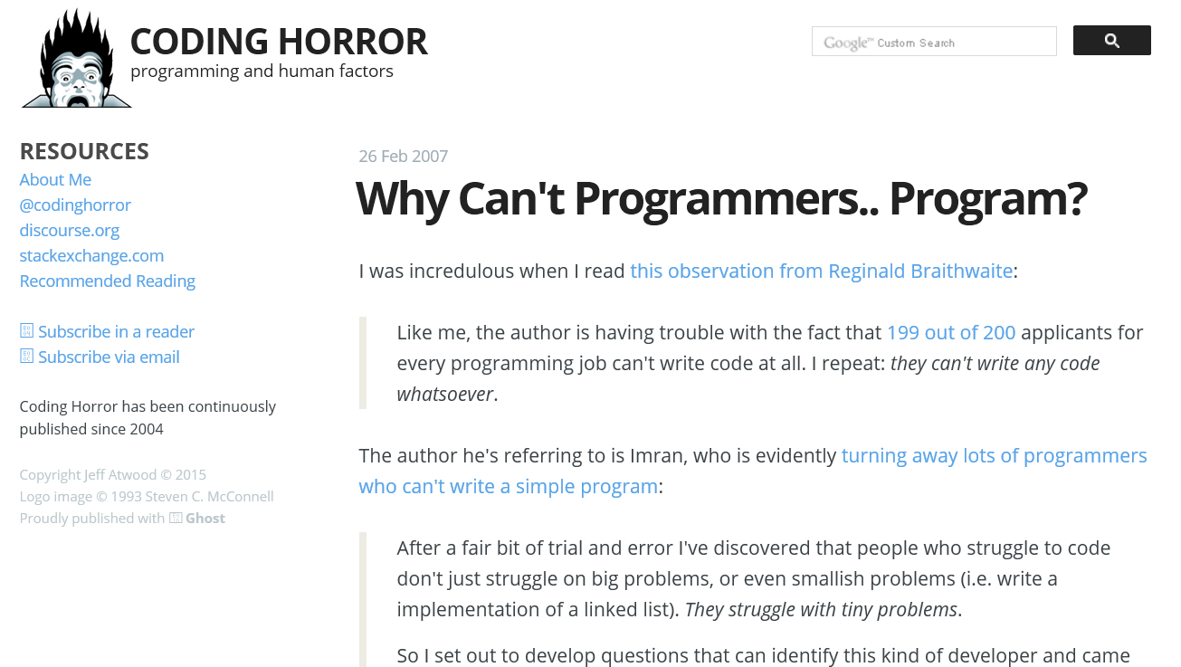

Slide 8
Concept: Statement
A statement is code that does something. If expressions are words, statements are sentences.
var i = 0; i++;
console.log("I'm " + "back!");
var a = 123 – "123" + 456;
if (1) console.log("Hello, World!");
while(true); //don't actually run this
Alternate definition: A statement is code that has side effects. A JavaScript program is a collection of statements.'
Advanced: Technically, you don't have to terminate your statements with semicolons. However, JavaScript will interpret your code in strange ways if you omit them, so it's not worth the risk leaving them out.
Notes:
Side effects: they do more than simply have a value. They affect the program running state in some way.
Statements should be ended with semicolons. The empty statement ; does nothing. Statements can be grouped together using curly braces. { }

Slide 9
Concept: Variables
A variable is a value with a name. The var keyword declares variables.
var myVariable; //Name: myVariable, Value: undefined
The assignment operator = assigns an expression to a variable.
var a = "the first letter of the alphabet";
var areYouAwesome = true || false;
var theAnswerToTheUniverse = 42;
Advanced: Variables do not have block {} scope. They have function scope. More on scope next time!
It is legal and harmless to declare a variable more than once with the var statement. The repeated declaration acts as an assignment. You can also declare/assign variables without the var statement, but then they become global variables.
Notes:
A variable assignment is the simplest kind of statement. Given an identifier, the assignment operator (=) assigns the value of the right hand expression to the identifier. Since var and = are both operators, you can declare and assign a variable in a single statement.
Imagine variables like buckets. We can put a name on buckets and put things in them. We can look up buckets by name. We can also remove items from buckets (reassigning the value) and add new items.
We say this has side effects because once we declare a variable, it stays declared (unless deleted), changing the state of our program. Notice how in the Console, we are able to access variables after declaring them, because they have been assigned in the global context of the Console.

Slide 10
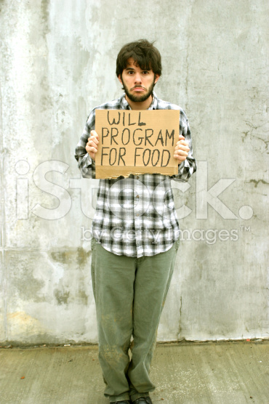
More on Variables
A variable's identifier expresses to the variable's value. We can use it anywhere in an expression!
var number = 1;
var number = number + 5;
var bean = "bag";
var myFurniture = "cardboard box and " + bean;
The result:
number => 6
bean => "bag"
myFurniture => "cardboard box and bag"

Slide 11


Variable Assignment: No Strict Types!
"An int is forever an int." - Java
"Be who you want to be." - JavaScript
Notes:
(Which kind of world do you want to live in?)

Slide 12
Variable Assignment: No Strict Types!
In Java, you might want to say…
int a = 4;
int b = a + 5;
a = "I don't want to be an integer" //ERROR
In JavaScript, variables do not enforce type.
var a = 4;
var b = a + 5;
a = "I can be a string!";
a => "I can be a string!"
Advanced: Since types are not declared along with variables, and the type of a variable is known only at runtime, JavaScript is a dynamically typed language. Java is statically typed - that means, the type of a variable is known at compile time.
Notes:
Why might this be useful? Suppose I have a variable used to describe something, such as an timestamp. Normally I might provide a number, perhaps representing milliseconds. But what if I don't have an exact timestamp? I might replace it with "not too long ago" instead. Then when the time comes around to report the value, I can get an appropriate value that's not limited to a given type.

Slide 13
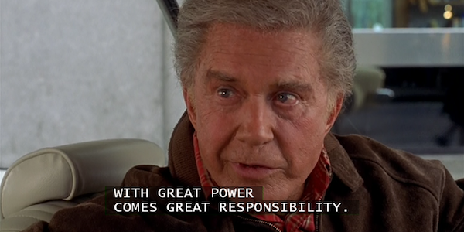
With great power…
With great power, comes a lot of unexpected types.
…something, something, responsibility. Be careful out there:
var number = 4;
var equation = number / 2; //equation => 2
number = "I can't believe it's not a number";
equation = number / 2; //equation => NaN
Recall the typeof operator:
typeof number => "string"
If only there were some way to structure our code based on conditions…
Advanced: Since class methods are simply properties of that class that are functions, it's always possible to test an object (expression) property before executing it: typeof Array.sort => "function" This avoids the dreaded "undefined is not a function" error.

Slide 14
Concept Redux: The JavaScript Console
The JavaScript console evaluates any JavaScript code.
The console runs in and modifies the same state as the JavaScript on the page. Embedded JavaScript is accessible from the console.
As such, variables declared once can be used later!
var myVariable = "this is my variable";
myVariable => "this is my variable";
They do not, however, survive a page reload.
Advanced: When you set breakpoints in the JavaScript debugger, the console's scope is the same as the scope of the code on the breakpoint itself. This makes it possible to inspect - and modify - variables in the current stack frame!
Notes:
To prove this, open up a JavaScript heavy page like Facebook. and then refer to a global variable like `bigPipe`
Then go to about:blank, and then try it: bigPipe is undefined.
A simple sample page, sample1.html, is included in the git repository. Clicking on the button reveals an alert that shows a global variable, theVariable. Modifying this variable via the console also modifies the variable shown when the button is clicked.

Slide 15
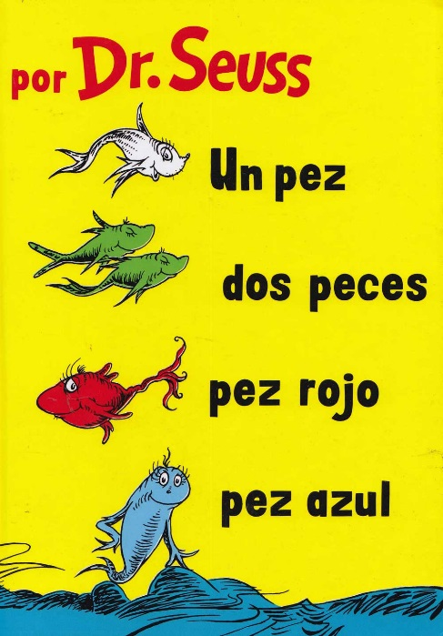
More on the Console
The console will always print the result of the last expression evaluated, but we can manually print messages for us with
console.log(expression);
where expression is coerced into a String. Try it (use shift + enter to start a new line in the console):
console.log(1 + "fish"); console.log(2 + "fish"); console.log("red fish"); console.log("blue fish");
Advanced: On older versions of Internet Explorer (9 and below), the console object is undefined unless the console itself is actually open.
Notes:
So, technically I haven't taught you what console.log(expression) actually means. We'll cover later, but for now, just trust me that it works.
console (global object)
. (property accessor)
log (property, probably a function)
() (function execution)
console.log() actually evaluates to undefined. Its side effect, of course, is printing out to the console.

Slide 16
Concept: if control flow statement
The if statement evaluates a given expression, and executes a statement if that expression is truthy.
if (expression) statement
if(true) console.log("true is true");
var myCondition = "healthy"; if(myCondition === "sick" || myCondition === "dirty") console.log("don't touch me");
var number = 8675309; if(number < 0) { console.log("psych!"); console.log("that's the wrong number!"); }

Slide 17
Wait, what's a statement again?
(Nobody really knows what a statement is.)
Some expressions are statements, but not all statements are expressions.
Expressions with Side Effects a = "b"
Statements
Control flow statements and keywords if
Expressions
Expressions that only have a value "asdf"

Slide 18
statement vs. statement vs. expression
if (expression) statement
expression refers to all expressions.
statement refers to all statements.
Control Flow Statements are statements, but aren't expressions.
Expressions with Side Effects a = "b"
Statements
Control flow statements and keywords if
Expressions
Expressions that only have a value "asdf"
Advanced: the for loop is special and accepts variable initializations in its expressions.
Notes:
For example, try:
if (if(true) "blue")
{
console.log("blue is truthy");
};
Syntax error!

Slide 19
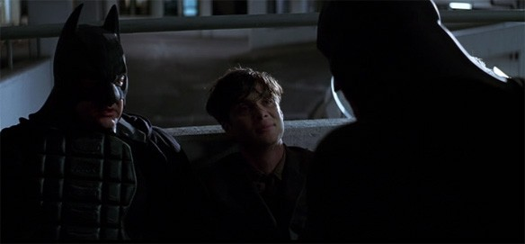
if / else
We can build on the if statement with else statements. The else statement runs the following statement if the expression was falsy.
if (expression) statement else statement
var identity = "bruce wayne"; if(identity === "bruce wayne") { console.log("I'M BATMAN!"); } else { console.log("I'M NOT WEARING HOCKEY PADS"); }

Slide 20
Concept: Ternary Operator
The Ternary operator lets us effectively use if in an expression. It is often called the "shorthand if".
expression1 ? expression2 : expression3
If expression1 is truthy, evaluate to expression2. Otherwise, evaluate to expression3.
var a = 4; var b = (a >= 1) ? (a + " is pos.") : (a + " isn't pos.");
b => "4 is pos"

Slide 21

More Ternary Operator
The Ternary Operator evaluates only two expressions:
"truth" ? console.log("one") : console.log("two")
As an expression operator, you can even put it inside an if condition:
var budget = 0; var intern = "Weston"; var useBudget = true; if(budget ? useBudget : intern) console.log("green screen time"); else console.log("just copy and paste it");
Concept: Copy + Paste
Notes:
d => 4
I didn't mention this, but the assignment operator expresses to the new value of the variable.
Note the difference between
budget ? useBudget : intern
vs.
(budget && useBudget) || intern
Admittedly, this is somewhat of a convoluted example. The point is that you can construct all kinds of expressions and stick them anywhere that takes them.

Slide 22
FizzBuzz Baby Edition, attempt 1
Does this code work? How can we improve it?
Notes:
var n = 1234; if(n % 3 === 0) console.log("Fizz"); else if(n % 5 === 0) console.log("Buzz"); else console.log(n);
Next:
var n = 1234; if(n % 3 === 0 && n % 5 === 0) console.log("FizzBuzz"); else if(n % 3 === 0) console.log("Fizz"); else if(n % 5 === 0) console.log("Buzz"); else console.log(n);

Slide 23
FizzBuzz Baby Edition, attempt 2
Does this code work? How can we improve it?
We forgot the case where n is divisible by both 3 and 5
Notes:
var n = 1234; if(n % 3 === 0 && n % 5 === 0) console.log("FizzBuzz"); else if(n % 3 === 0) console.log("Fizz"); else if(n % 5 === 0) console.log("Buzz"); else console.log(n);
Next:
var n = 1234; var out = ""; if(n % 3 === 0) out = out + "Fizz"; if(n % 5 === 0) out = out + "Buzz"; if(out !== "") console.log(out); else console.log(n);

Slide 24
FizzBuzz Baby Edition, attempt 3
Does this code work? How can we improve it?
We forgot the case where n is divisible by both 3 and 5
We're repeating ourselves and checking the same conditions twice
Notes:
var n = 1234; var out = ""; if(n % 3 === 0) out = out + "Fizz"; if(n % 5 === 0) out = out + "Buzz"; if(out !== "") console.log(out); else console.log(n);
Next:
var n = 1234; var out = ""; if(n % 3 === 0) out = out + "Fizz"; if(n % 5 === 0) out = out + "Buzz"; if(!out) console.log(out); else console.log(n);

Slide 25
FizzBuzz Baby Edition, attempt 4
Does this code work? How can we improve it?
We forgot the case where n is divisible by both 3 and 5
We're repeating ourselves and checking the same conditions twice
The empty string is falsy
Notes:
var n = 1234; var out = ""; if(n % 3 === 0) out = out + "Fizz"; if(n % 5 === 0) out = out + "Buzz"; if(!out) console.log(out); else console.log(n);
Next:
var n = 1234; var out = ""; if(n % 3 === 0) out = out + "Fizz"; if(n % 5 === 0) out = out + "Buzz"; console.log(out ? out : n);

Slide 26
FizzBuzz Baby Edition, attempt 5
Does this code work? How can we improve it?
We forgot the case where n is divisible by both 3 and 5
We're repeating ourselves and checking the same conditions twice
The empty string is falsy
We can skip the if statement with the ternary op.
Notes:
var n = 1234; var out = ""; if(n % 3 === 0) out = out + "Fizz"; if(n % 5 === 0) out = out + "Buzz"; console.log(out ? out : n);
Ask the audience the bonus bit: how to print NaN if n is not a number?

Slide 27
Wrap Up & Review
Today we covered the statement: code with side effects. Some, but not all, statements are expressions.
The var keyword lets us declare variables. They can be assigned a value and used later in expressions. Variables are dynamically typed!
We can use the browser console to print information and interact with the page.
The if/else control flow statement allows us to run code based on the truthiness of an expression. The ternary operator lets us build conditional expressions.

Slide 28
Q&A + Feedback
Thanks for coming!
Please fill out the anonymous feedback form before you leave:
http://bit.ly/1UNrjwn
Next week's workshop…?

